Slide 1


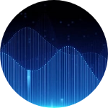
AudioGuard
Speech · Music · Environmental Noise — Classical ML Audio Classifier
Team:
Arya Remani
Aleena Antony
Ananthanarayanan B

Slide 2
CORE FOUNDATIONS
Introduction, Objectives & Dataset Exploration

Slide 3

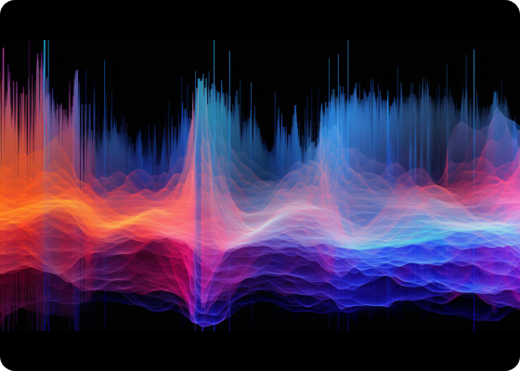
System Overview
The Objective
AudioGuard is a robust classifier designed to distinguish between speech, music, and noise signals.
Unlike modern deep learning black-boxes, this system relies on hand-crafted acoustic features and classical machine learning, ensuring high interpretability and efficiency.

Slide 4





The MUSAN Corpus
Dataset Profile
Target Classes
109 Hours of Total Audio
Speech: Conversational & Read
High-quality WAV format
Multilingual (12 languages)
Music: Various Genres & Vocal/Inst
Stratified Splitting Used
Noise: Technical & Ambient sounds

Slide 5
TECHNICAL PIPELINE
Feature Engineering & Model Architecture

Slide 6






The ML Architecture
Preprocessing
Feature Selection
Classification
Pre-emphasis & Peak Normalization on 3s segments @ 22,050 Hz.
153 raw dimensions reduced to top 80 via Mutual Information.
Parallel training of SVM, KNN, and Gradient Boosting ensembles.

Slide 7
Acoustic Feature Groups
Feature Group | Extracted Metrics | Dimensions
MFCC (Raw + Δ + Δ²) | Mean, Variance, Skewness | 140
Spectral Centroid / BW | Timbral brightness and spread | 4
Spectral Flux / Rolloff | Spectral change & high-freq cutoff | 4
Temporal Features | Zero Crossing Rate & Short-Time Energy | 5
TOTAL RAW FEATURES: 153 → SELECTED: 80

Slide 8
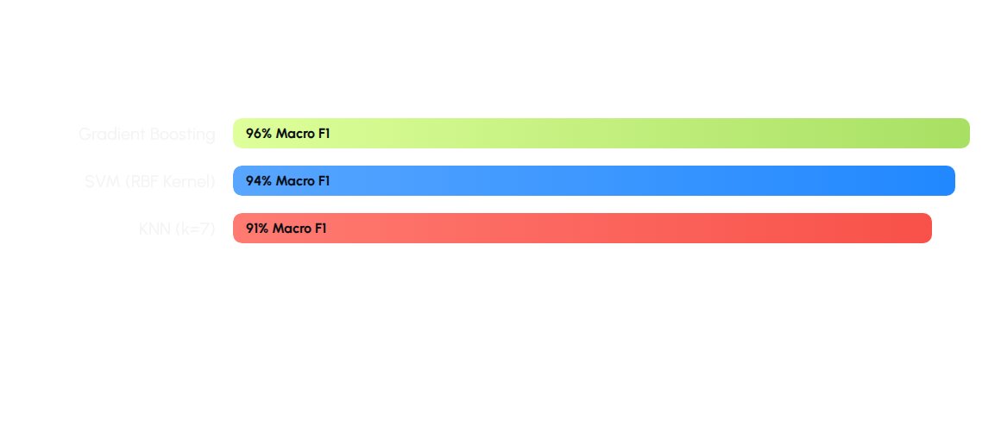
Model Performance Metrics
* Gradient Boosting shows the best overall performance and is used as the default in the deployment app.

Slide 9
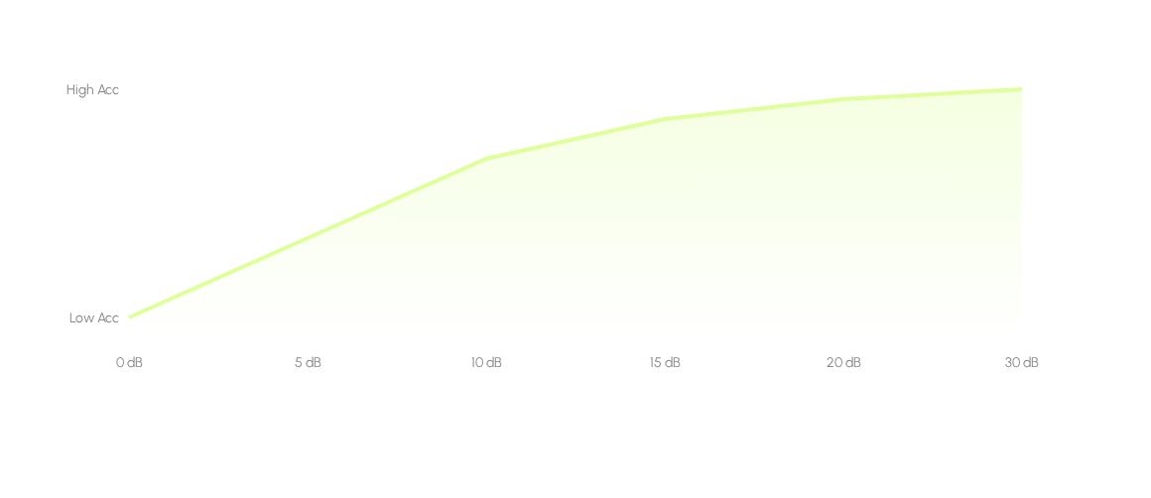
SNR Robustness Analysis
SVM degrades gracefully, retaining usable accuracy at ≥15 dB SNR (Cafe Environment).

Slide 10
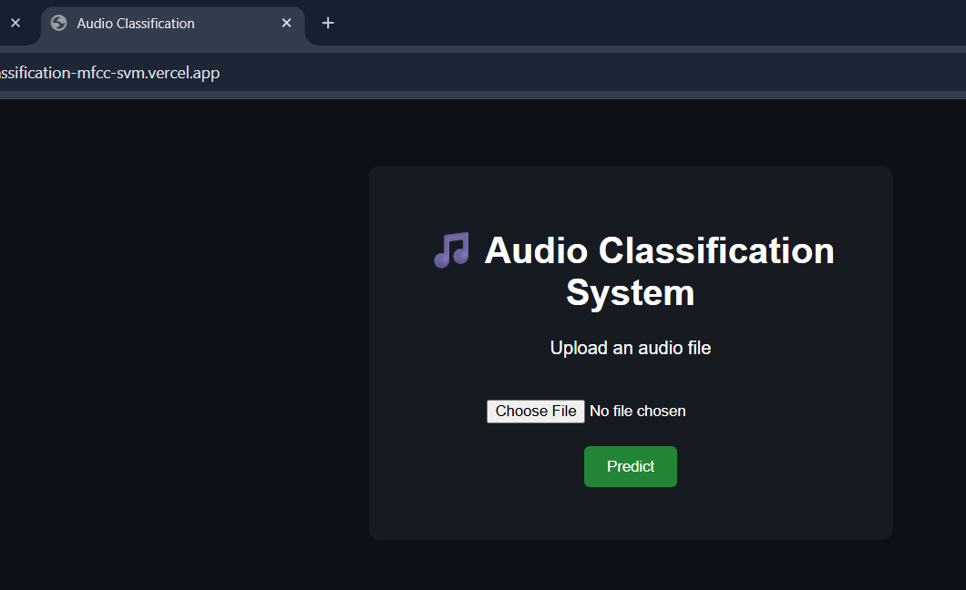
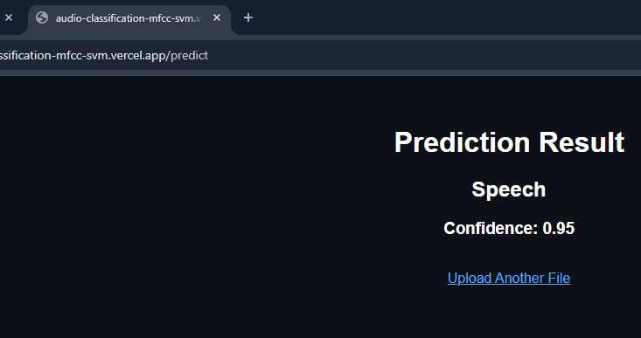
Streamlit Deployment
A user-friendly web interface allows users to upload .wav, .mp3, or .flac files for real-time classification.
Drag-and-drop file upload
Prediction probability bar
Streamlit dark-theme UI
Link:
audio-classification-mfcc-svm.vercel.app

Slide 11
Questions
Thank you for your attention!

